Slide 1
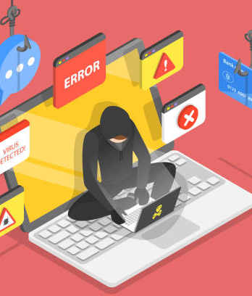
Phishing Awareness Training
Learn how to recognize and avoid phishing attacks
Presentation by:
Aditya yewatikar

Slide 2


What is Phishing !
Definition : Phishing is a cyber-attack where criminals disguise themselves as legitimate sources to steal sensitive information.
Purpose : attackers trick victims into revealing passwords, credit card details, or downloading malware.
Common targets: individuals, employees, organizations, and even government institutions.
Example: an email pretending to be from a bank asking you to "verify your account."

Slide 3

Common Types of Phishing Attacks
Email Phishing: Fake emails from banks, social media, or companies asking for personal data.
Spear Phishing: Targeted attacks on specific individuals (e.g., an email pretending to be from your boss).
Smishing (SMS Phishing): Fraudulent text messages with fake links or urgent warnings.
Vishing (Voice Phishing): Scammers calling, pretending to be from customer service or law enforcement.
Website Phishing: Fake websites designed to steal login credentials (e.g., a PayPal login page that isn’t real).
Clone Phishing: A hacker copies a real email but replaces links with malicious ones

Slide 4

How to Recognize a Phishing Email
Suspicious sender : check the email address closely (e.G., "Support@paypa1.Com" instead of "support@paypal.Com").
Urgency or threats : phrases like "act now! Your account is compromised!"
Spelling and grammar errors : legitimate companies rarely send poorly written emails.
Fake links : hover over links before clicking; see where they actually lead.
Unexpected attachments : PDF, ZIP, or word files could contain malware.
Unusual requests : asking for login credentials, payment details, or gift card purchases.

Slide 5

How to Protect Yourself from Phishing
Verify the sender before clicking on links or downloading files.
Use multi-factor authentication (MFA) for an extra layer of security.
Do not share sensitive information via email or phone calls.
Use security software and keep it updated.
Check website urls carefully – secure sites start with "https://" and have a padlock icon.
Be cautious with pop-ups – do not enter login details in pop-up windows.
Train employees and individuals regularly on phishing risks.
Enable spam filters to block suspicious emails.
This Photo by Unknown Author is licensed under CC BY-NC

Slide 6

What to Do if You Fall for a Phishing Scam?
Change passwords immediately – use strong, unique passwords. .
Report the incident to your IT department, manager, or bank.
Monitor your accounts for suspicious transactions.
Scan your device for malware using antivirus software.
Warn others in your organization to prevent further attacks.

Slide 7
Real-Life Phishing Examples
Example 1: fake amazon email asking to update payment details.
Example 2: A phishing text from "netflix" stating your account is locked.
Example 3: a call from "microsoft support" claiming your computer has a virus
Breakdown of a phishing email: highlight sender, links, and urgency tactics used.

Slide 8

Conclusion & Final Tips
Think before you click !
Verify emails and links before taking any action.
Stay updated on phishing tactics.
Report phishing attempts to IT/Security Teams.
If in doubt, contact the company directly through official channels

Slide 9
Thank You
“ Stay Safe , Stay Smart ! "

